Slide 1
Telecom Customer Churn
Christian Fernandez

Slide 2
Agenda
Introduction
A look at customer data
Features with relation to churn
Model preparation and results
Conclusion

Slide 3
Introduction
Collected data from 7,032 customers over a 3-month period to try and address customer churn.
20 data points were collected for each customer including :
Age demographic and household composition
Service subscriptions
Contract type and
Charges

Slide 4
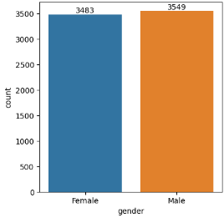
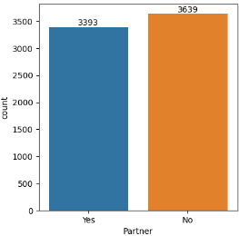
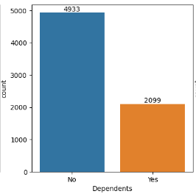
Customer Demographics

Slide 5
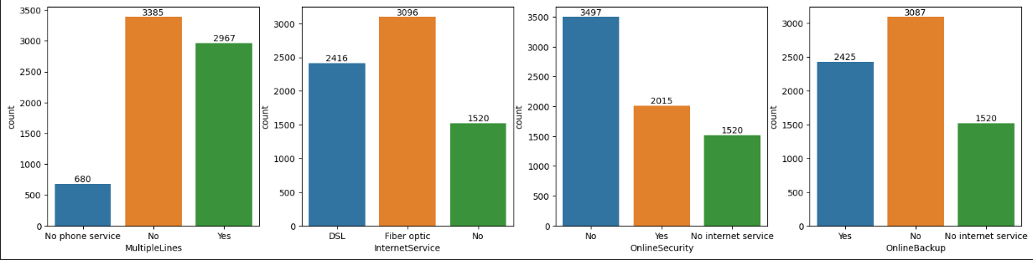
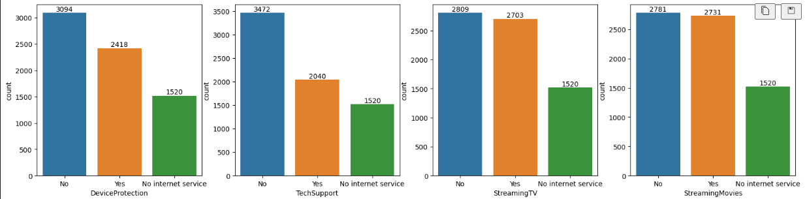
Service Subscriptions

Slide 6
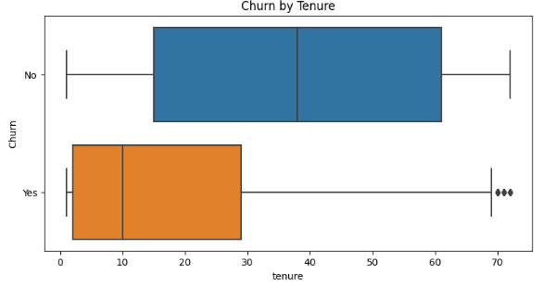
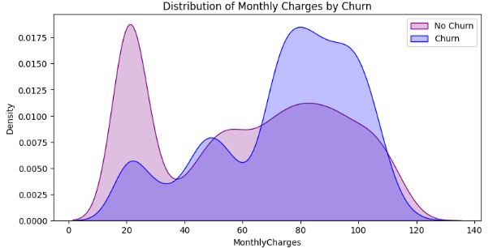
Features with relation to Churn
Notes:
Here we can see this note.

Slide 7
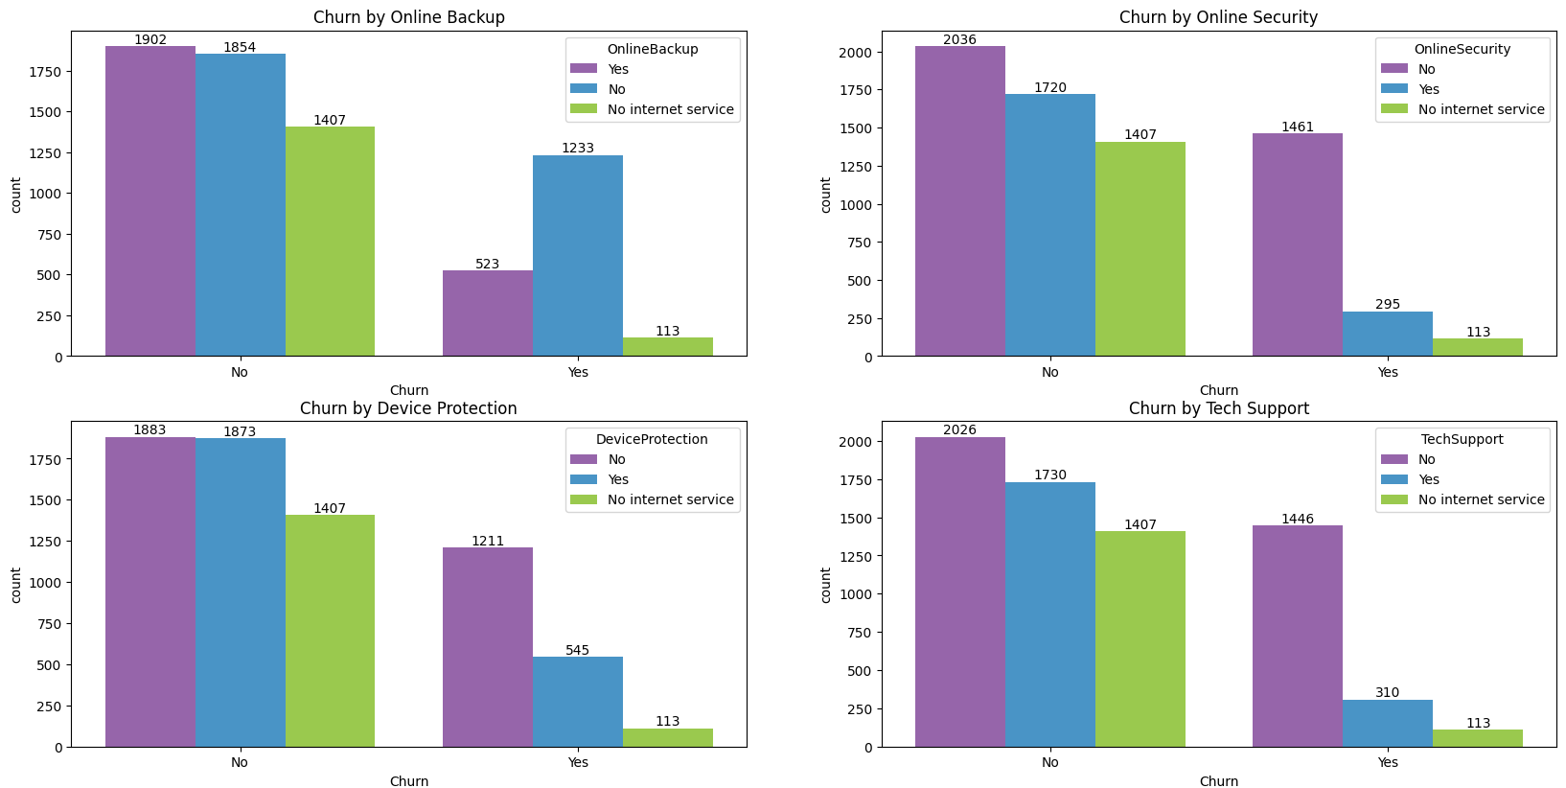

Slide 8
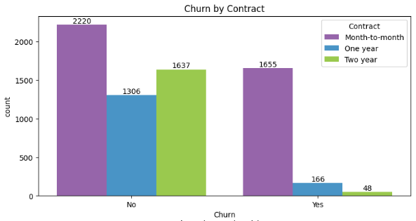
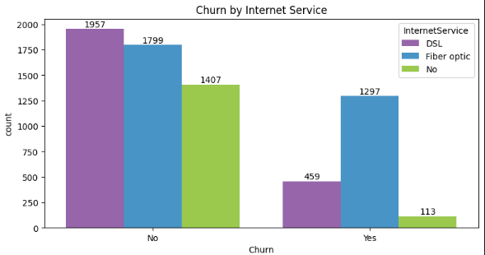

Slide 9
Model Preparation
Convert
Split
Scale
Predict
All categorical features were converted to numerical to facilitate model interpretability.
Data was subsequently split into two sets for training and testing our algorithms.
4,922 rows of data were used to train our predictive models and the remaining 2,110 were used to test them.

Slide 10
Model Results
After preparing our data, 5 models were built and then tuned to achieve better prediction accuracy.
Our best model was the Support Vector Machine with a final, tuned accuracy of 80 %.
SVMs are based on the idea of finding a hyperplane that best divides a dataset into two classes. The further away a data point is from the hyperplane, the higher the accuracy.
 | Initial Model | Tuned Model
Log Regression | 79.5 % | 79.7 %
SVM | 79.8 % | 80 %
Decision Tree | 71.7 % | 78 %
K-Nearest Neighbors | 75.4 % | 78.6 %
Random Forest Classifier | 78.9 % | 78.9 %

Slide 11
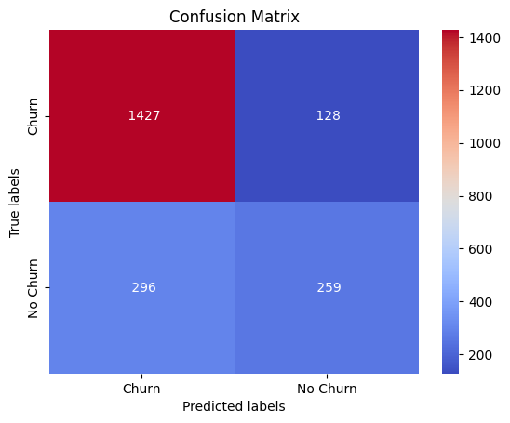
Confusion Matrix
Here we can see the confusion matrix for our Support Vector model which shows how many predictions are correct and incorrect per class.
Out of the 2,110 customers that were used to train the model, 1,686 were accurately predicted. 1,427 to churn and 259 to not churn.

Slide 12
Conclusion
Checking for feature importance for our model reveals that these are the 3 biggest contributors to a customer’s decision to churn.
Fiber Optic internet service being the most important factor is in line with our initial findings derived from our exploratory analysis shown earlier.
This company would do good by improving this service and/or focusing more on marketing DSL internet service to current and potential customers as this seems to lead to much higher customer satisfaction.
 | Importance
Fiber Optic Internet | 0.031
Tenure | 0.029
One Year Contract | 0.010

Slide 13



THANK YOU !
Dataset : Kaggle
Tools used : Python, Jupyter, Powerpoint

